Slide 1
Heart Disease Predictor
Final Project
Data Science with Python part 2
EMK Center
Rashik Intisar Siddiquee

Slide 2
Problem
Objective
To develop a model to predict the risk of heart disease in 10 years
To determine the major factor leading to heart disease
To determine who are most vulnerable to heart disease risk

Slide 3
Motivation
More opportunity for intervention and preventive measures
Reduce insurance cost
Reduce medical cost
Improve effectiveness of the population

Slide 4
Dataset
4238 rows
16 columns
1 target (binary)
15 independent (both numeric and categorical(dummy)
All categorical are converted to dummies, interpreted to numeric
Missing values present

Slide 5
Data Preprocessing
Data cleanup
No need as data is mostly clean (relief :P)
Renaming
Missing Data
No missing value in target column (more relief :P)
Normal human body metrics were used to fill missing data
Mean value is also used. Median could be used.
Data Scaling
MinMax scaling

Slide 6
Visualization
Countplot
Barplot
Catplot
Boxplot
Violinplot
Distplot

Slide 7
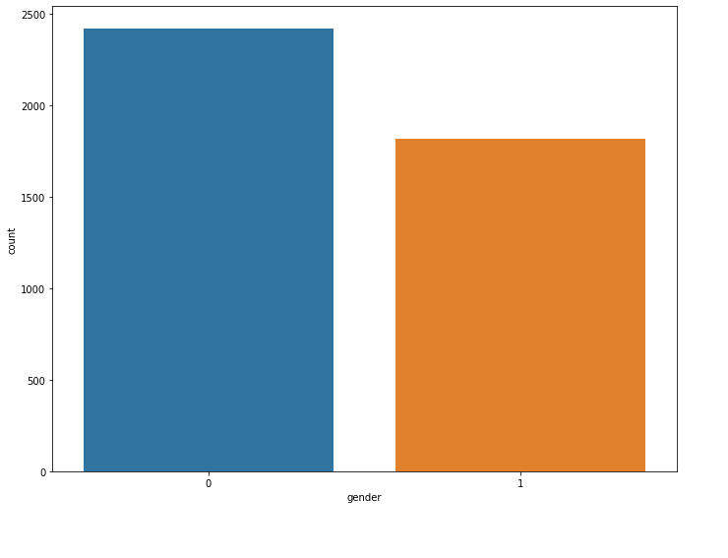
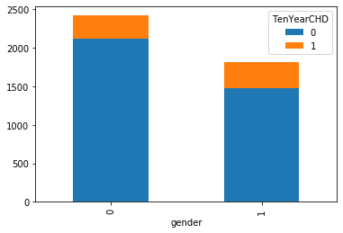
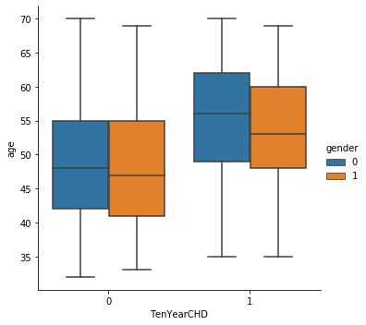
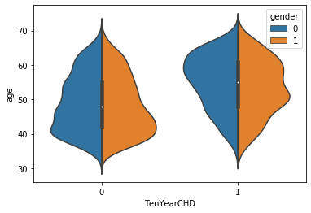
Gender

Slide 8
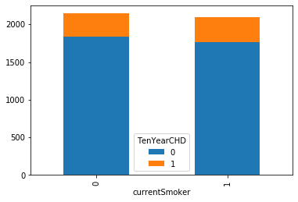
Smoker
No major difference between the two group

Slide 9
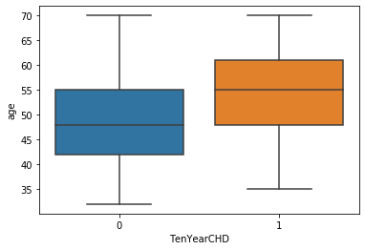
Age
Large difference between mean age between two groups.
Aged people have more risk of CHD

Slide 10
Correlation
SysBP
BPMeds
Prevalenthyp
DiaBP
CigsPerday
CurrentSmoker
glucose
diabetes

Slide 11
Chi squared test
Significant relationship with target variable
Gender
Education
BPMeds
Prevalent hypertension
Diabetes
Prevalent Stroke

Slide 12
ANOVA
Unequal mean between two groups
Age
Glucose
Cigarettes per day
Total Cholesterol
BMI
Blood pressure

Slide 13
Model
Classification problem
Logistic Regression
Scikit learn
Statsmodel
K nearest neighbor
SVC
Decision Tree
Backward elimination
Random Forest

Slide 14
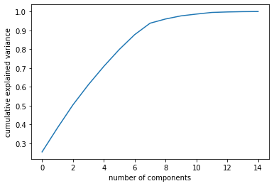
6 factors account for 85% of the variation

Slide 15
gender 1.656171
age 1.018453
education 0.802762
prevalentHyp 2.932675
diabetes 3.381247
sysBP 0.994671
BMI 0.921543

Slide 16
Males have 65% high risk
1 year increase, increases 1.8% risk
Each level upgrade in education related to 20% reduction in risk
Hypertension increases risk by 200%
Diabetes by 238%

Slide 17
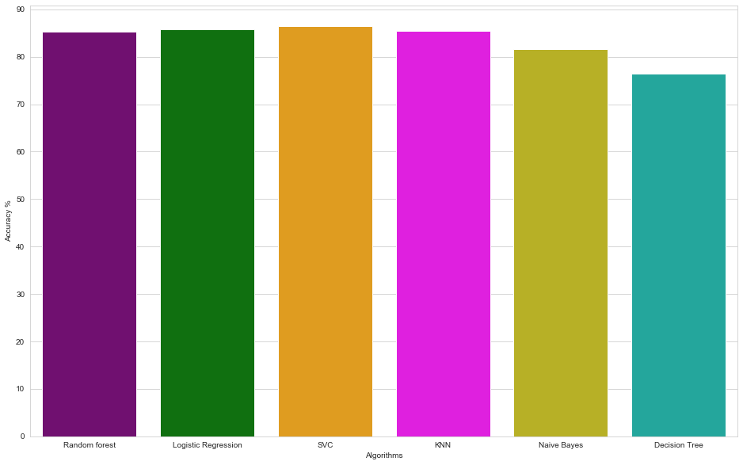
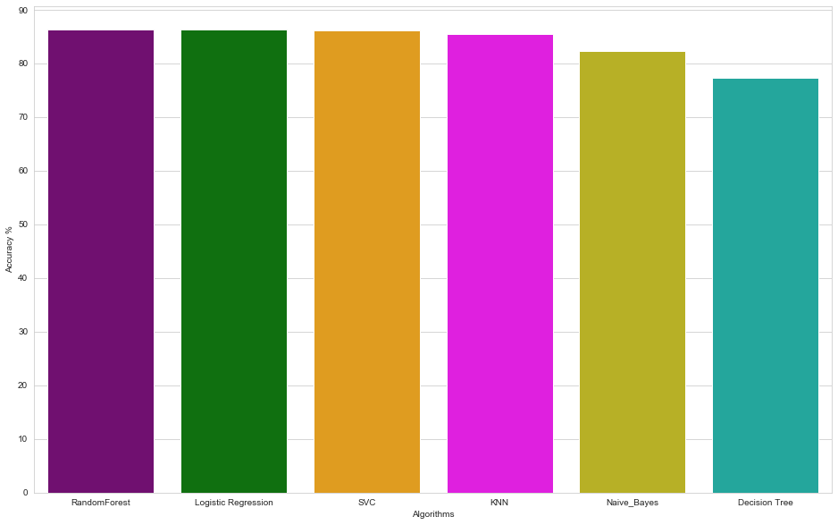
All Variables
Reduced

